Slide 1
Cloud application
Session 11
Course : COSC6100001 - Cloud Infrastructure
D6825 - Samuel Philip

Slide 2
Learning outcomes
(C4) Analysis : identify problems that can be solved using cloud global infrastructure
(C2) Comprehension : group Classify real-worlds problems in accordance with cloud computing infrastructure
(C4) Analysis : analyze identifying problems and choose proper Cloud Services and Cloud Infrastructure
(C5) Synthesis : design Cloud computing architecture and infrastructure and implementation on applciations

Slide 3
Outline
Cloud Application Development and Architectural Styles
Workflow Patterns
Current Cloud Applications and New Applications Opportunities
Cloud for Science and Engineering

Slide 4
Cloud Application Development and Architectural Style

Slide 5
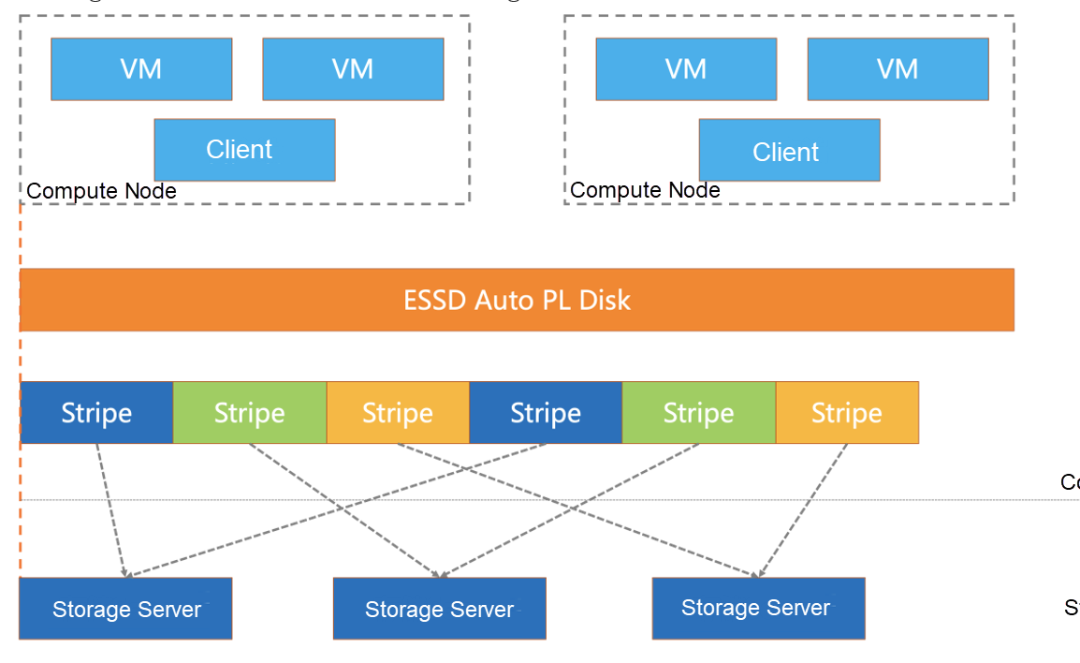
Cloud Application Development
Challenges
Developing efficient cloud applications is hampered by the inherent imbalance between computing, I/O, and communication bandwidth
Other challenges include optimizing server usage against cost/timing constraints, side effects of shared infrastructure, reliability concerns, multi-stage applications, data storage performance in data-intensive apps, handling metadata, and logging
Notes:
Other challenges include optimizing server usage against cost/timing constraints, side effects of shared infrastructure, reliability concerns, multi-stage applications, data storage performance in data-intensive apps, handling metadata, and logging

Slide 6
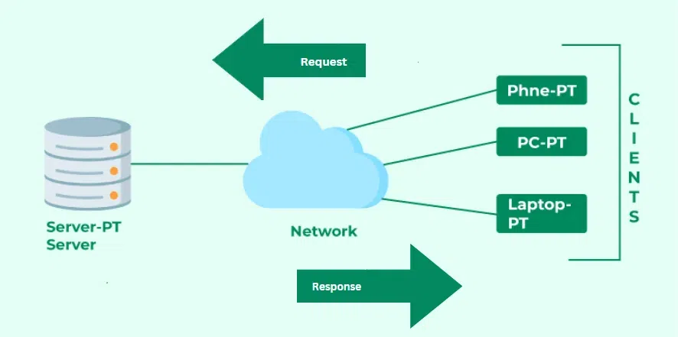
Cloud Application Development
Architectural styles
Cloud computing is based on the client–server paradigm.
Cloud computing is based on the client–server paradigm and mostly uses request–response communication between clients and stateless servers.
A stateless system is simpler, more robust, and scalable; a client does not have to be concerned with the state of the server; if the client receives a response to a request, this means that the server is up and running; if not, it should resend the request later.
Client-server architecture

Slide 7
Cloud Application Development
Architectural consideration
Several consideration when choosing an architectural for cloud application development
Key factors when choosing an architectural style include neutrality (protocol ability to use different transport protocols like TCP and UDP), extensibility (ability to add functions like security), and independence (ability to support different programming styles).
Client-server architecture

Slide 8
Communication Middleware/Protocols

Slide 9
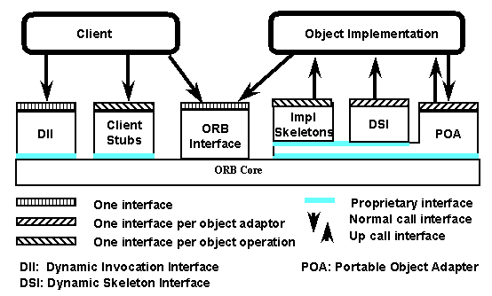
protocols
Object request broker (ORB)
is middleware that facilitates communication in networked applications.
The sending site ORB transforms data structures used internally and transmits a byte sequence over the network. The receiving site ORB maps the byte sequence to data structures used internally by the receiving process.
Hence, allowing components from different vendors to communicate seamlessly.

Slide 10
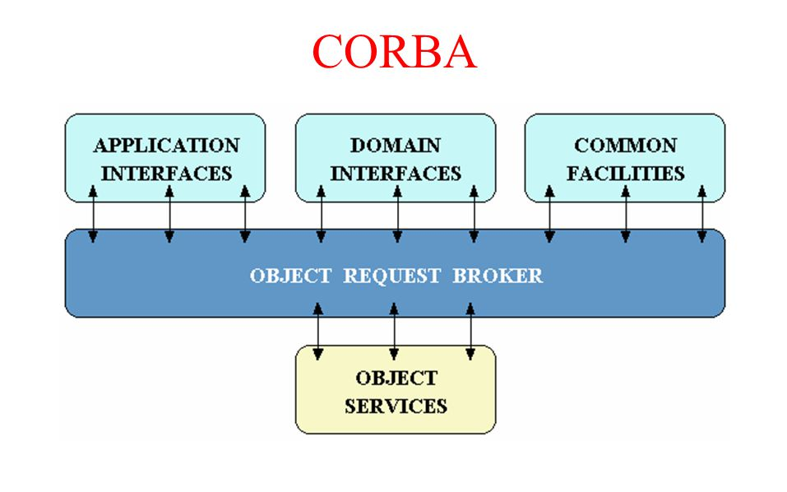
protocols
Common Object request broker architecture (cORBa)
Enabled networked applications using different languages/architectures to work together.
Cobra relies on the Interface Definition Language (IDL) to specify object interfaces
An IDL representation is then mapped to the set of programming languages including: C, C++, Java, Smalltalk, Ruby, Lisp, and Python. Networked applications pass CORBA by reference and pass data by value.

Slide 11
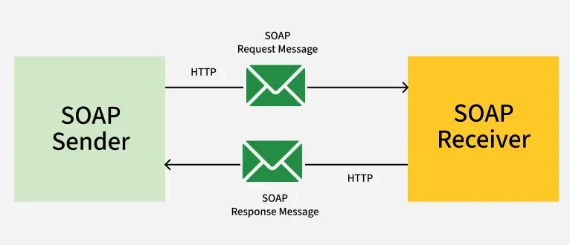
protocols
Simple Object Access Protocol (SOAP)
SOAP message format is based on the Extensible Markup Language (XML).
SOAP uses TCP and more recently, UDP transport protocols, but it can also be stacked above other application layer protocols such as HTTP, SMTP, or JMS.
The processing model of SOAP is based on a network consisting of senders, receivers, intermediaries, message originators, ultimate receivers, and message paths. SOAP is an underlying layer of Web Services.

Slide 12
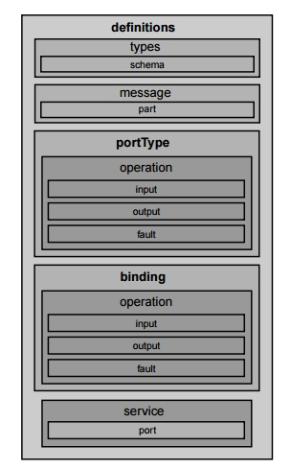
protocols
Web Services Description Language (WSDL)
SOAP message format is based on the Extensible Markup Language (XML).
SOAP uses TCP and more recently, UDP transport protocols, but it can also be stacked above other application layer protocols such as HTTP, SMTP, or JMS.
The processing model of SOAP is based on a network consisting of senders, receivers, intermediaries, message originators, ultimate receivers, and message paths. SOAP is an underlying layer of Web Services.

Slide 13
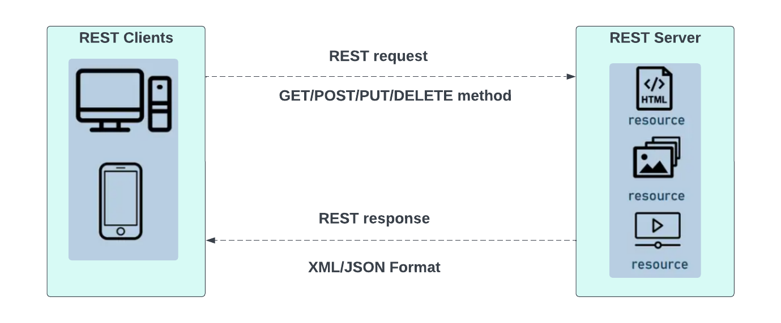
protocols
Representational State Transfer (REST)
a simpler software architecture for distributed hypermedia systems using stateless servers.
It is platform- and language-independent, supports data caching, and primarily uses HTTP for CRUD (Create/Read/Update/Delete) operations.
REST almost always uses HTTP for all four CRUD (Create/Read/Update/Delete) operations; it uses GET, PUT, and DELETE to read, write, and delete the data, respectively.
REST is an easier to use alternative to RPC, CORBA, or web services such as SOAP or WSDL.

Slide 14
Workflow patterns

Slide 15
Workflow pattern
The term workflow pattern refers to the temporal relationships among the tasks of a process. The workflow description languages and the mechanisms to control the enactment of a case must have provisions to support these temporal relationships.
The patterns of workflow are classified in several categories: basic, advanced branching and synchronization, structural, state-based, cancelation, and patterns involving multiple instances.

Slide 16
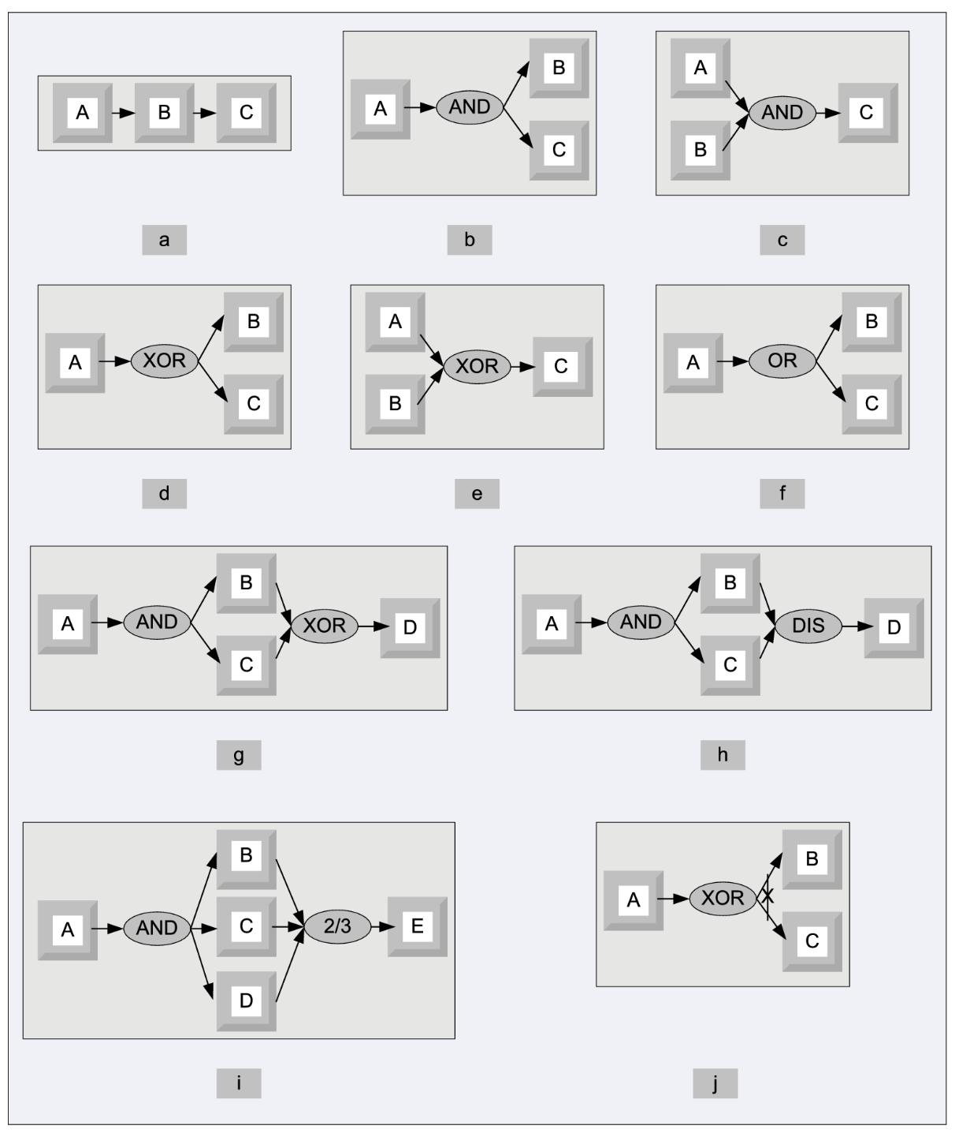
Workflow patterns
Basic workflow pattern
Basic workflow patterns.
Sequence;
AND split;
Synchronization;
XOR split;
XOR merge;
OR split;
Multiple Merge;
Discriminator;
N out of M join;
Deferred Choice.
Notes:
Sequence—occurs when several tasks have to be scheduled one after the completion of the other.
AND split—requires several tasks to be executed concurrently. Both tasks B and C are activated when task A terminates.
Synchronization—an activity can start only after several concurrent activities finish execution; task C can start only after both tasks A and B terminate.
XOR split—requires a decision; after the completion of task A, either B or C can be activated.
XOR join—several alternatives are merged into one; task C is enabled when either A or B terminates.
OR split—choose multiple alternatives out of a set; after completion of task A, one could activate either B or C, or both.
Multiple merge—allows multiple activations of a task and does not require synchronization after the execution of concurrent tasks; once A terminates, tasks B and C execute concurrently. When the first of them, say B, terminates, then task D is activated; then, when C terminates, D is activated again.
Discriminator—waits for a number of incoming branches to complete before activating the subsequent activity then, it waits for the remaining branches to finish without taking any action until all of them have terminated; next, it resets itself.
N out of M join—provides a barrier synchronization; assuming M>N tasks run concurrently, N of them have to reach the barrier before the next task is enabled; in our “example, any two out of the three tasks A, B, and C have to finish before E is enabled.
Deferred choice—similar to XOR split but the choice is not made explicitly and the run-time environment decides what branch to take.

Slide 17
Traditional transaction-oriented system workflows
Vs cloud computing
The emphasis in a transactional model is placed on the contractual aspect of a transaction; in a workflow the enactment of a case is sometimes based on a “best-effort” model where the agents involved will do their best to attain the goal state, but there is no guarantee of success.
A critical aspect of the transactional model in database applications is maintaining a consistent state of the database; a cloud is an open system; thus its state is considerably more difficult to define.

Slide 18
Traditional transaction-oriented system workflows
Vs cloud computing
Database transactions are typically short-lived; the tasks of a cloud workflow could be long lasting.
A database transaction consists of a set of well-defined actions that are unlikely to be altered during the execution of the transaction. However, the process description of a cloud workflow may change during the lifetime of a case.
Notes:
The individual tasks of a cloud workflow may not exhibit the traditional properties of database transactions. For example, consider durability, which means that, at any instance of time before reaching the goal state, a workflow may roll back to some previously encountered state and continue from there on an entirely different path. A task of a workflow could be either reversible or irreversible. Sometimes, paying a penalty for reversing an action is more profitable in the long run than continuing on a wrong path.
Resource allocation is a critical aspect of the workflow enactment on a cloud without an immediate correspondent for database transactions.

Slide 19
Current Cloud Applications and New Applications opportunities

Slide 20
Current Cloud Applications
Vs cloud computing
Existing cloud applications can be divided in several broad categories:
  processing pipelines;
  batch processing systems; and
  web applications

Slide 21
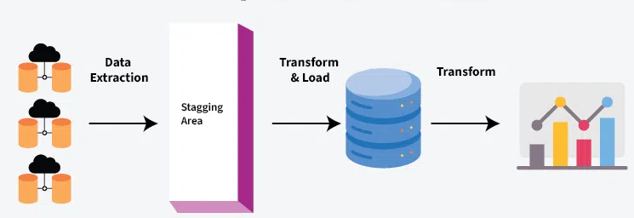
Processing Pipelines
Processing pipelines are data-intensive and sometimes compute-intensive applications that represent a fairly large segment of applications currently running on a cloud.
Several types of data processing applications can be identified:
  Indexing;
  Data mining;
  Image processing;
  Video transcoding;
  Document processing;
Notes:
Indexing; processing pipeline supports indexing of large datasets created by web-crawler engines.
Data mining; processing pipeline supports searching large sets of records to locate items of interests.
Image processing; a number of companies allow users to store their images on the cloud, e.g., Flickr (flickr.com) and Picasa (http://picasa.google.com/). Image-processing pipelines support image conversion, e.g., enlarge an image or create thumbnails, and compress or encrypt images.
Video transcoding; processing pipeline translates one video format to another, e.g., AVI to MPEG.
Document processing; processing pipeline converts very large collection of documents from one format to another, e.g., from Word to PDF or encrypts the documents; they could also use OCR (Optical Character Recognition) to produce digital images of documents.

Slide 22
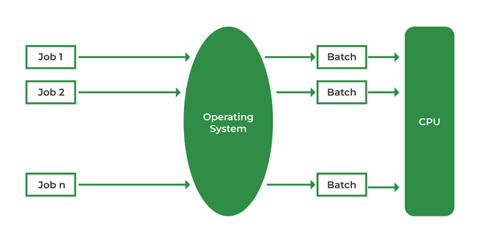
Batch Processing Systems
Batch processing systems also cover a broad spectrum of data-intensive applications in enterprise computing.
A nonexhaustive list of batch processing applications includes:
Generation of daily, weekly, monthly, and annual activity reports for organizations in retail, manufacturing, and other economic sectors.
Processing, aggregation, and summaries of daily transactions for financial institutions, insurance companies, and healthcare organizations.
Inventory management for large corporations.
Processing billing and payroll records.
Management of the software development, e.g., nightly updates of software repositories.

Slide 23
Web Applications
Lastly, cloud applications in the area of web access are of increasing importance.
Several groups of web sites have a periodic or temporary presence, e.g., web sites for conferences or other events.
Other limited-time web site are used for promotional activities, or web sites that “sleep” during the night and auto-scale during the day.

Slide 24
New Applications Opportunities
Another class of new applications could be parallel batch processing based on programming abstractions such as MapReduce.
Mobile interactive applications that process large volumes of data from different types of sensors and services that combine more than one data source, e.g., mashups, are obvious candidates for cloud computing.
Science and engineering could benefit from cloud computing as many applications are compute- and data-intensive. Similarly, a cloud dedicated to education would be extremely useful. Mathematical software, e.g., MATLAB® and Mathematica, could also run on the cloud.

Slide 25
Cloud for Science and Engineering

Slide 26
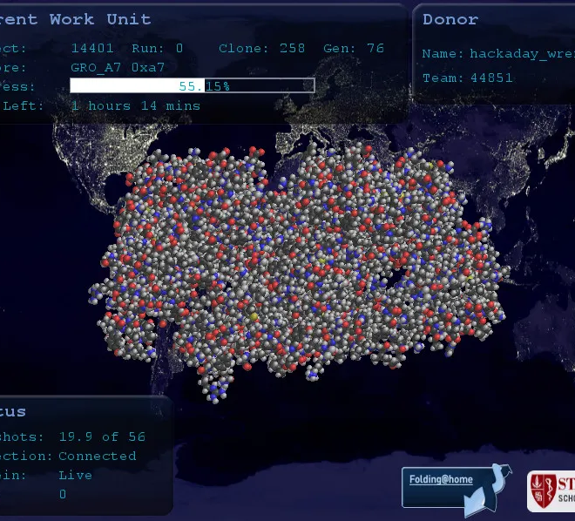
Cloud for science
eScience unifies experiment, theory, and simulation; data captured from measuring instruments, or generated by simulations is processed by software systems
The generic problems in virtually all areas of science are:
  collection of experimental data;
  management of a very large volumes of data;
  building and execution of models;
  integration of data and literature;
  documentation of the experiments;
  sharing the data with others; and
  data preservation for long periods of time.
folding@home as example of science use case

Slide 27
Cloud for science
A typical example of a problem faced by agencies and research groups is data discovery in large scientific data sets.
The process of online data discovery can be viewed as an ensemble of several phases:
  recognition of the information problem;
  generation of search queries using one or more search engines;
  evaluation of the search results;
  evaluation of the web documents; and
  comparing information from different sources.
folding@home as example of science use case

Slide 28

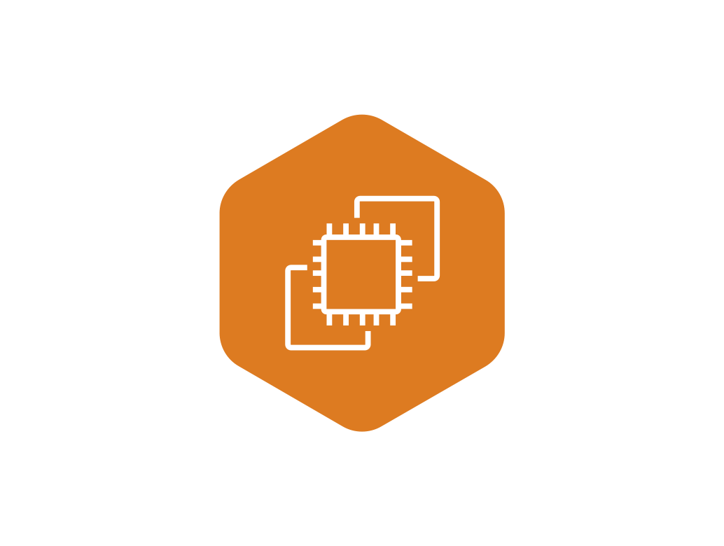
High performance computing example
Aws
The set of applications used at NERSC (National Energy Research Scientific Computing Center) and presents the results of a comparative benchmark of EC2 and three supercomputers.
Some of the codes used are:
  CAM (Community Atmosphere Mode), the atmospheric component of CCSM (Community Climate System Model), is used for weather and climate modeling.
  GAMESS (General Atomic and Molecular Electronic Structure System) is used for ab initio quantum chemistry calculations.
  GTC (Gyrokinetic) is a code for fusion research.
  IMPACT-T (Integrated Map and Particle Accelerator Tracking Time) is a code for the prediction and performance enhancement of accelerators.

Slide 29
Systems compared to EC2
Carver—a 400-node IBM iDataPlex cluster with quad-core Intel Nehalem processors running at 2.67 GHz and with 24 GB of RAM (3 GB/core). Each node has two sockets; a single Quad Data Rate (QDR) IB link connects each node to a network that is locally a fat-tree with a global two-dimensional mesh. The codes were compiled with the Portland Group suite version 10.0 of and Open MPI version 1.4.1.
Franklin—a 9660-node Cray XT4; each node has a single quad-core 2.3 GHz AMD Opteron “Budapest” processor with 8 GB of RAM (2 GB/core). Each processor is connected through a 6.4 GB/s bidirectional HyperTransport interface to the interconnect via a Cray SeaStar-2 ASIC. The SeaStar routing chips are interconnected in a tri-dimensional torus topology, where each node has a direct link to its six nearest neighbors. Codes were compiled with the Pathscale or the Portland Group version 9.0.4.

Slide 30
Systems compared to EC2
Lawrencium—a 198-node (1584 core) Linux cluster; a compute node is a Dell Poweredge 1950 server with two Intel Xeon quad-core 64 bit and 2.66 GHz Harpertown processors with 16 GB of RAM (2 GB/core). A compute node is connected to a Dual Data Rate InfiniBand network configured as a fat tree with a 3:1 blocking factor. Codes were compiled using Intel 10.0.018 and Open MPI 1.3.3.
The virtual cluster at Amazon had four EC2 CUs (Compute Units), two virtual cores with two CUs each, and 7.5 GB of memory (an m1.large instance in Amazon parlance); a Compute Unit is approximately equivalent to a 1.0–1.2 GHz 2007 Opteron or 2007 Xeon processor. The nodes are connected via a gigabit Ethernet.

Slide 31
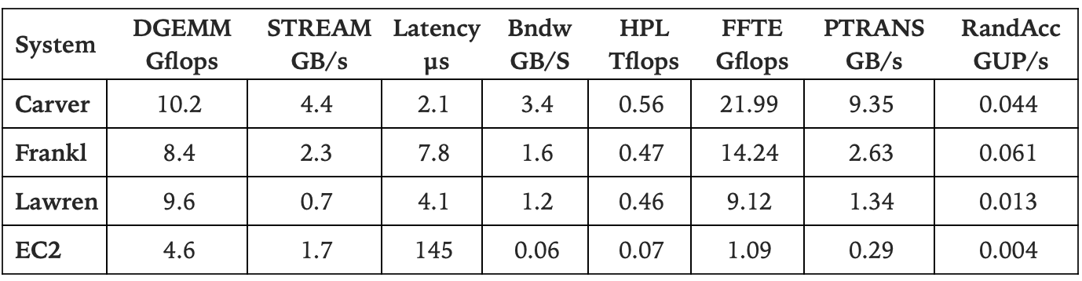
Systems compared to EC2
The results give us some idea about the characteristics of scientific applications likely to run efficiently on the cloud. Communication intensive applications will be affected by the increased latency (more than 70 times larger then Carver) and lower bandwidth (more than 70 times smaller than Carver).

Slide 32
Exercise
Find other use case of cloud computing for science

Slide 33
References
Marinescu, Dan C. (2022). Cloud Computing Theory and Practice: 3rd Edition. Morgan Kaufmann Publishers. ISBN: 978-0-323-85277-7

Slide 34
Thankyou

